Slide 1
Distribution:
-a placement, location, arrangement, disposition
-the frequency of occurrence

Slide 2

Distribution:
-a placement, location, arrangement, disposition
-the frequency of occurrence
Values are distributed (arranged) as they compare to the Mean
They are arranged according to their tendency to fall around the mean
They are arranged according to their deviations from the mean
aka
aka
Mean

Slide 3
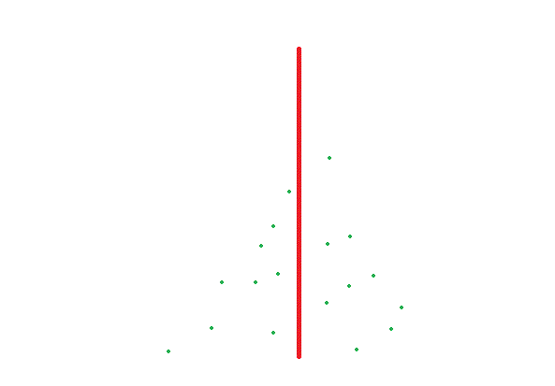
Distribution:
-a placement, location, arrangement, disposition
-the frequency of occurrence
Values are distributed (arranged) as they compare to the Mean
They are arranged according to their tendency to fall around the mean
They are arranged according to their deviations from the mean
aka
aka
Mean

Slide 4
Distribution: -a placement, location, arrangement, disposition
-the frequency of occurrence
Values are distributed (arranged) as they compare to the Mean
They are arranged according to their tendency to fall around the mean
They are arranged according to their deviations from the mean
aka
aka
Mean

Slide 5
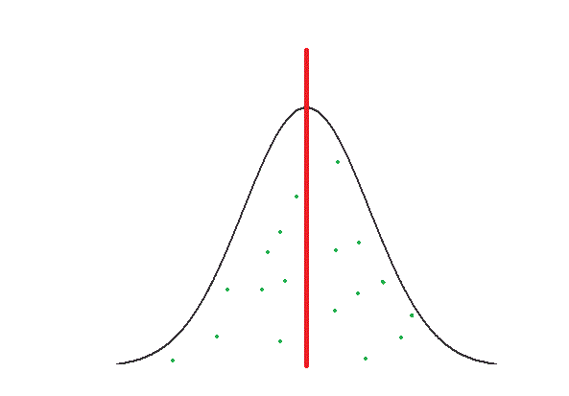
Distribution:
-a placement, location, arrangement, disposition
-the frequency of occurrence
Values are distributed (arranged) as they compare to the mean
They are arranged according to their tendency to fall around the mean
They are arranged according to their deviations from the mean
aka
aka
Mean

Slide 6
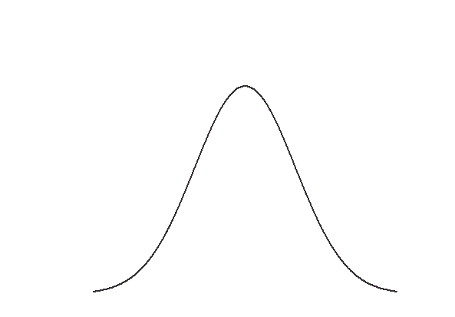
Normal Distribution
“The Bell Curve”

Slide 7
Normal Distribution
“The Bell Curve”
Mean

Slide 8
Normal Distribution
“The Bell Curve”
Mean
5’10”

Slide 9
Normal Distribution
“The Bell Curve”
Mean
5’10”
5’8”
6’0”
5’6”
6’2”
5’4”
6’4”
5’2”
6’6”
5’0”
6’8”

Slide 10
Normal Distribution
“The Bell Curve”
Mean
Holy moley there are a lot of average men!
5’10”
5’8”
6’0”
5’6”
6’2”
5’4”
6’4”
5’2”
6’6”
Very tall and lonely, unless they play for the NBA
5 foot and lonely
5’0”
6’8”

Slide 11





7’11”
7’8”
Average
5’10”
Average
5’6”
2’6”
2’5”

Slide 12

Standardized Scores
Standardized Score = Z Score
Z Score = a number indicating how many standardized units a raw score is from the mean of a distribution
Raw Score = the original data collected; data that has not been manipulated/changed
Hello nice lady!!

Slide 14
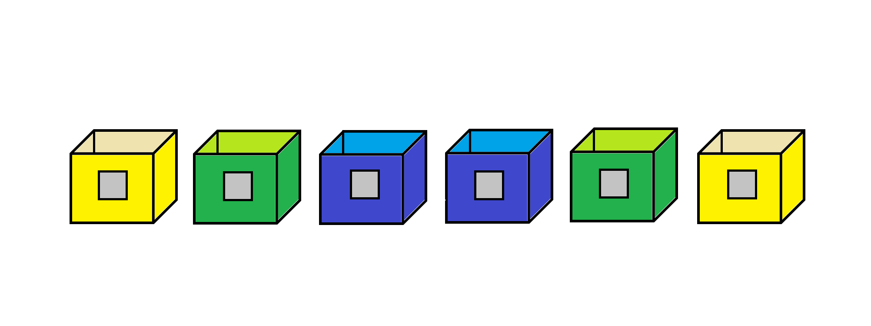
3
2
1
1
2
3

Slide 15

-3
-2
-1
0
1
2
3
3
2
1
1
2
3
Mean = 0

Slide 16
-3
-2
-1
0
1
2
3
1 S.D.
1 S.D.
1 S.D.
1 S.D.
1 S.D.
1 S.D.
3
2
1
1
2
3
Mean = 0

Slide 17
< 0.13%
2%
13.5%
34%
34%
13.5%
2%
< 0.13%
-3
-2
-1
0
1
2
3
1 S.D.
1 S.D.
1 S.D.
1 S.D.
1 S.D.
1 S.D.
3
2
1
1
2
3
Mean = 0

Slide 18


7’8”
3 SD
6’7”
2 SD
6’4”
1 SD
6’1”
Average
5’10”
1 SD
2 SD
5’7”
3 SD
5’4”
5’1”
2’6”

Slide 19




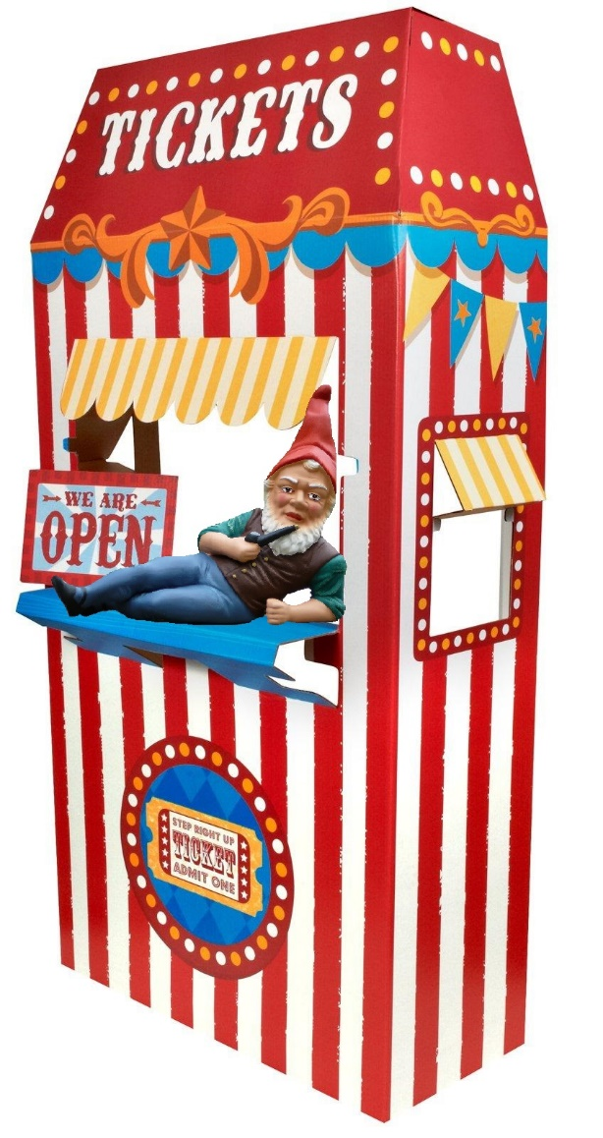
















Below Average Height
Above Average Height
5’7” – 5’10”
5’10” – 6’1”
5’4” – 5’7”
6’1” – 6’4”
5’0” – 5’4”
6’4” – 6’7”

Slide 20

< 0.13%
2%
13.5%
34%
34%
13.5%
2%
< 0.13%
-3
-2
-1
0
1
2
3
1 S.D.
1 S.D.
1 S.D.
1 S.D.
1 S.D.
1 S.D.
3
2
1
1
2
3
Mean = 0

Slide 21
< 0.13%
2%
13.5%
34%
34%
13.5%
2%
< 0.13%
-3
-2
-1
0
1
2
3
1 S.D.
1 S.D.
1 S.D.
1 S.D.
1 S.D.
1 S.D.
3
2
1
1
2
3
Mean = 0

Slide 22
< 0.13%
2%
13.5%
34%
34%
13.5%
2%
< 0.13%
-3
-2
-1
0
1
2
3
1 S.D.
1 S.D.
1 S.D.
1 S.D.
1 S.D.
1 S.D.
3
2
1
1
2
3
Mean = 0

Slide 23
< 0.13%
2%
13.5%
34%
34%
13.5%
2%
< 0.13%
-3
-2
-1
0
1
2
3
1 S.D.
1 S.D.
1 S.D.
1 S.D.
1 S.D.
1 S.D.
3
2
1
1
2
3
Mean = 0

Slide 24
< 0.13%
2%
13.5%
34%
34%
13.5%
2%
< 0.13%
-3
-2
-1
0
1
2
3
1 S.D.
1 S.D.
1 S.D.
1 S.D.
1 S.D.
1 S.D.
3
2
1
1
2
3
Mean = 0

Slide 25
< 0.13%
2%
13.5%
34%
34%
13.5%
2%
< 0.13%
-3
-2
-1
0
1
2
3
1 S.D.
1 S.D.
1 S.D.
1 S.D.
1 S.D.
1 S.D.
3
2
1
1
2
3
Mean = 0

Slide 26
< 0.13%
2%
13.5%
34%
34%
13.5%
2%
< 0.13%
-3
-2
-1
0
1
2
3
1 S.D.
1 S.D.
1 S.D.
1 S.D.
1 S.D.
1 S.D.
3
2
1
1
2
3
Mean = 0

Slide 27
< 0.13%
2%
13.5%
34%
34%
13.5%
2%
< 0.13%
-3
-2
-1
0
1
2
3
1 S.D.
1 S.D.
1 S.D.
1 S.D.
1 S.D.
1 S.D.
3
2
1
1
2
3
Mean = 0

Slide 28
< 0.13%
2%
13.5%
34%
34%
13.5%
2%
< 0.13%
-3
-2
-1
0
1
2
3
1 S.D.
1 S.D.
1 S.D.
1 S.D.
1 S.D.
1 S.D.
3
2
1
1
2
3
Mean = 0

Slide 29
< 0.13%
2%
13.5%
34%
34%
13.5%
2%
< 0.13%
-3
-2
-1
0
1
2
3
1 S.D.
1 S.D.
1 S.D.
1 S.D.
1 S.D.
1 S.D.
3
2
1
1
2
3
Mean = 0

Slide 30
< 0.13%
2%
13.5%
34%
34%
13.5%
2%
< 0.13%
-3
-2
-1
0
1
2
3
1 S.D.
1 S.D.
1 S.D.
1 S.D.
1 S.D.
1 S.D.
3
2
1
1
2
3
Mean = 0

Slide 31
< 0.13%
2%
13.5%
34%
34%
13.5%
2%
< 0.13%
-3
-2
-1
0
1
2
3
1 S.D.
1 S.D.
1 S.D.
1 S.D.
1 S.D.
1 S.D.
3
2
1
1
2
3
Mean = 0

Slide 32







< 0.13%
2%
13.5%
34%
34%
13.5%
2%
< 0.13%
-3
-2
-1
0
1
2
3
1 S.D.
1 S.D.
1 S.D.
1 S.D.
1 S.D.
1 S.D.
3
2
1
1
2
3
Mean = 0

Slide 33
< 0.13%
2%
13.5%
34%
34%
13.5%
2%
< 0.13%
-3
-2
-1
0
1
2
3
1 S.D.
1 S.D.
1 S.D.
1 S.D.
1 S.D.
1 S.D.
3
2
1
1
2
3
Mean = 0

Slide 34
< 0.13%
2%
13.5%
34%
34%
13.5%
2%
< 0.13%
-3
-2
-1
0
1
2
3
1 S.D.
1 S.D.
1 S.D.
1 S.D.
1 S.D.
1 S.D.
3
2
1
1
2
3
Mean = 0

Slide 35

< 0.13%
2%
13.5%
34%
34%
13.5%
2%
< 0.13%
-3
-2
-1
0
1
2
3
1 S.D.
1 S.D.
1 S.D.
1 S.D.
1 S.D.
1 S.D.
3
2
1
1
2
3
Mean = 0

Slide 36
< 0.13%
2%
13.5%
34%
34%
13.5%
2%
< 0.13%
-3
5’1 – 5’4”
-2
5’4 – 5’7”
-1
5’7 – 5’10”
0
5’10 – 6’1”
1
6’1 – 6’4”
2
6’4 – 6’7”
3
1 S.D.
1 S.D.
1 S.D.
1 S.D.
1 S.D.
1 S.D.
3
2
1
1
2
3
Mean = 0

Slide 37
68%
< 0.13%
2%
13.5%
34%
34%
13.5%
2%
< 0.13%
-3
5’1 – 5’4”
-2
5’4 – 5’7”
-1
5’7 – 5’10”
0
5’10 – 6’1”
1
6’1 – 6’4”
2
6’4 – 6’7”
3
1 S.D.
1 S.D.
1 S.D.
1 S.D.
1 S.D.
1 S.D.
3
2
1
1
2
3
Mean = 0

Slide 38
81.5%
< 0.13%
2%
13.5%
34%
34%
13.5%
2%
< 0.13%
-3
5’1 – 5’4”
-2
5’4 – 5’7”
-1
5’7 – 5’10”
0
5’10 – 6’1”
1
6’1 – 6’4”
2
6’4 – 6’7”
3
1 S.D.
1 S.D.
1 S.D.
1 S.D.
1 S.D.
1 S.D.
3
2
1
1
2
3
Mean = 0

Slide 39
99%
< 0.13%
2%
13.5%
34%
34%
13.5%
2%
< 0.13%
-3
5’1 – 5’4”
-2
5’4 – 5’7”
-1
5’7 – 5’10”
0
5’10 – 6’1”
1
6’1 – 6’4”
2
6’4 – 6’7”
3
1 S.D.
1 S.D.
1 S.D.
1 S.D.
1 S.D.
1 S.D.
3
2
1
1
2
3
Mean = 0

Slide 40
50% > 5’10”
< 0.13%
2%
13.5%
34%
34%
13.5%
2%
< 0.13%
-3
5’1 – 5’4”
-2
5’4 – 5’7”
-1
5’7 – 5’10”
0
5’10 – 6’1”
1
6’1 – 6’4”
2
6’4 – 6’7”
3
1 S.D.
1 S.D.
1 S.D.
1 S.D.
1 S.D.
1 S.D.
3
2
1
1
2
3
Mean = 0

Slide 41
50% < 5’10”
< 0.13%
2%
13.5%
34%
34%
13.5%
2%
< 0.13%
-3
5’1 – 5’4”
-2
5’4 – 5’7”
-1
5’7 – 5’10”
0
5’10 – 6’1”
1
6’1 – 6’4”
2
6’4 – 6’7”
3
1 S.D.
1 S.D.
1 S.D.
1 S.D.
1 S.D.
1 S.D.
3
2
1
1
2
3
Mean = 0

Slide 42
16% > 6’1”
< 0.13%
2%
13.5%
34%
34%
13.5%
2%
< 0.13%
-3
5’1 – 5’4”
-2
5’4 – 5’7”
-1
5’7 – 5’10”
0
5’10 – 6’1”
1
6’1 – 6’4”
2
6’4 – 6’7”
3
1 S.D.
1 S.D.
1 S.D.
1 S.D.
1 S.D.
1 S.D.
3
2
1
1
2
3
Mean = 0

Slide 43
84% < 6’1”
< 0.13%
2%
13.5%
34%
34%
13.5%
2%
< 0.13%
-3
5’1 – 5’4”
-2
5’4 – 5’7”
-1
5’7 – 5’10”
0
5’10 – 6’1”
1
6’1 – 6’4”
2
6’4 – 6’7”
3
1 S.D.
1 S.D.
1 S.D.
1 S.D.
1 S.D.
1 S.D.
3
2
1
1
2
3
Mean = 0

